Slide 1

The Public Utility Data Liberation (PUDL) Project
By Varshini Burgula

Slide 2
PROBLEM
To find out which Natural Resource is demanded the most in order to generate power in the USA?

Slide 3
DATA DESCRIPTION
The data used is- Fuel cost receipts (reported in EIA-923 Schedule 2, Part A).
Data Partition- 75% as training set and 25% as test set.
Data Normalization- Z score
Cluster: K-means

Slide 4
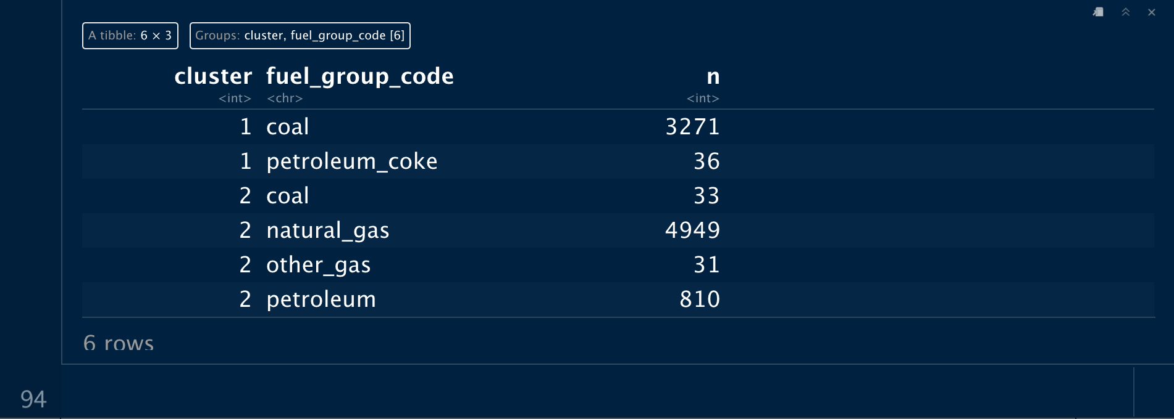

ANALYSIS
There are 2 clusters formed. The first cluster consists coal and petroleum coke while cluster 2 contains coal, natural gas, other gas and petroleum.

Slide 5
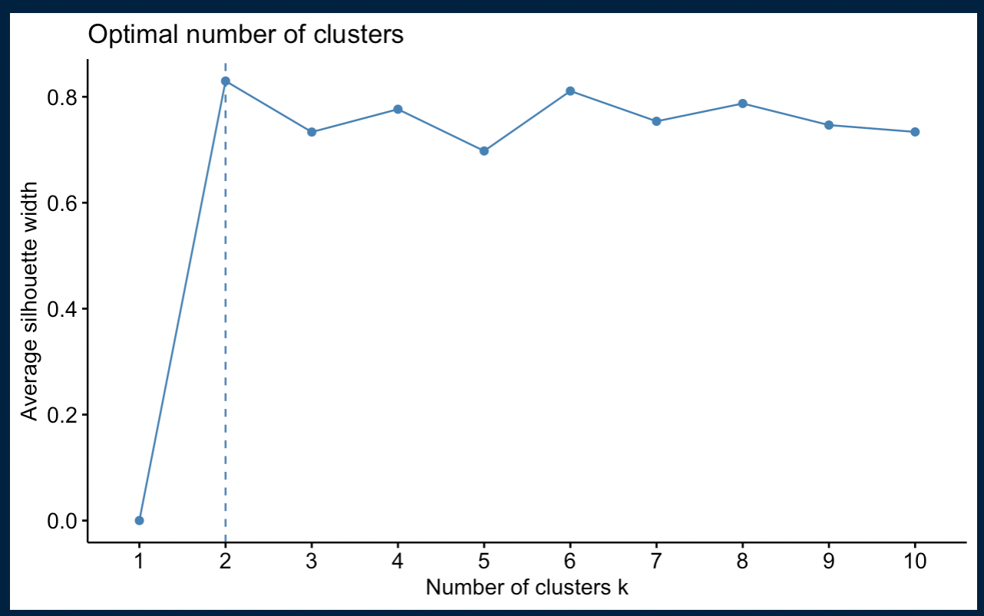
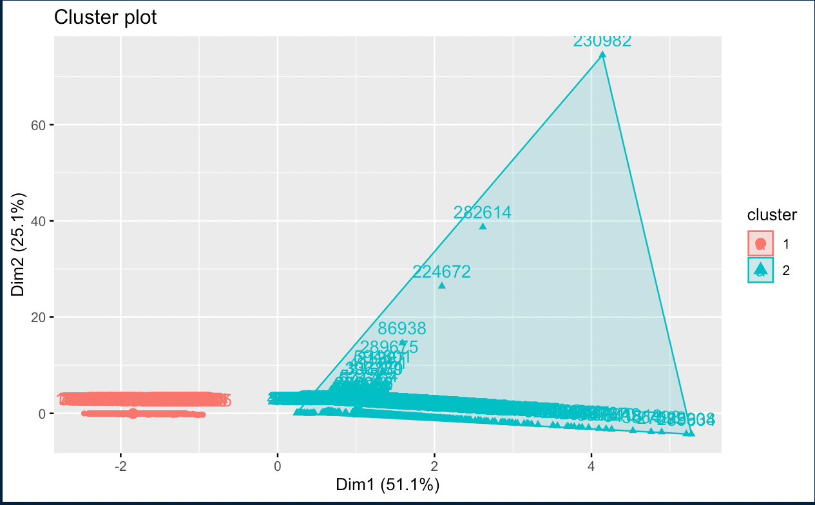

Slide 6
CONCLUSION
As per the clusters formed, cluster 1 has the highest mmbtu which means that these resources can provide the automobile industry the highest energy providing natural resource.
The quality which would be highly considered by the population in USA would definitely prefer on going for the best quality with the reasonable price i.e. coal.
Therefore, coal would be the most in demand when compared to others.

